Slide 1
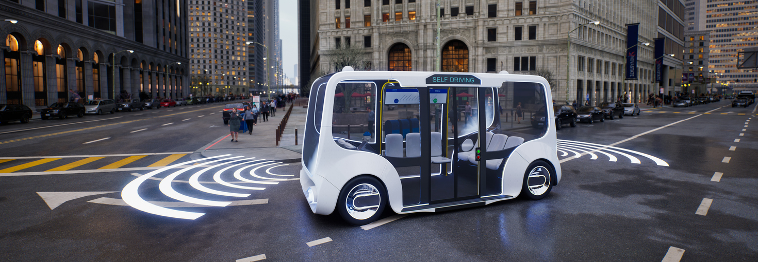
Title
Authors
Problem Statement
Method
Results
Conclusion
References
Authors
Seminar
Lecturer

